Slide 1
Artificial Intelligence Lab
Learning Journey
Course Code: CSE-06133116 • Duration: January – June 2025
North East University, Bangladesh
Instructor: Mr. Razorshi Prozzwal Talukder, Lecturer, Department of CSE
Presented By: Sanjida Khanom

Slide 2




Introduction to Artificial Intelligence
Artificial Intelligence (AI) is the simulation of human intelligence in machines that are programmed to think like humans and mimic their actions. It's transforming industries and daily life.
Healthcare
Transportation
From diagnostics to personalized treatment plans.
Powering self-driving vehicles and logistics optimization.
Finance
Entertainment
Detecting fraud and automating trading.
Enhancing gaming experiences and content recommendation.
AI has evolved from early theoretical concepts to advanced machine learning and deep learning applications, shaping the future across diverse sectors.

Slide 3
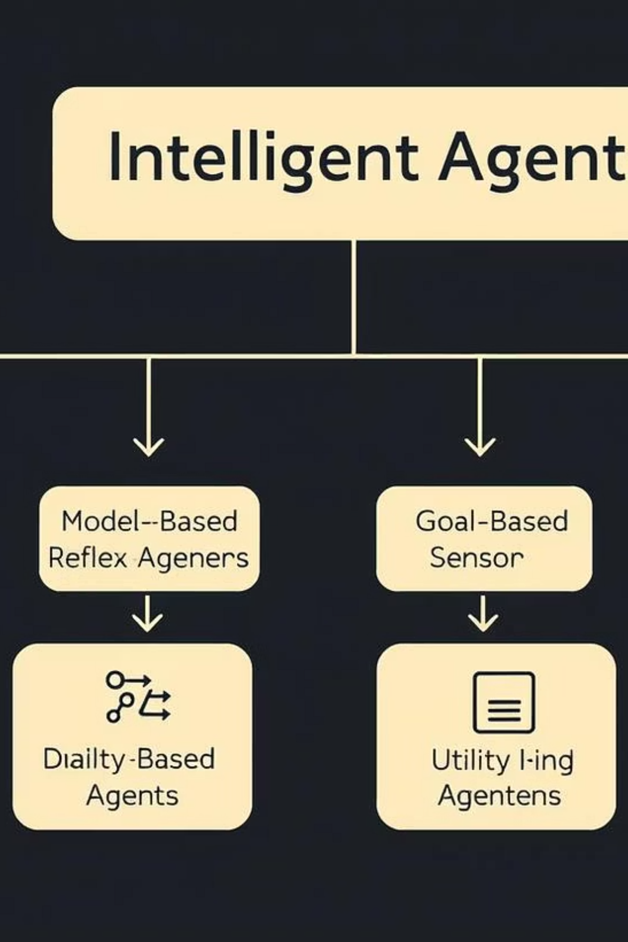




Understanding Intelligent Agents
Intelligent agents perceive their environment through sensors and act upon that environment through effectors, striving to achieve their goals.
Simple Reflex Agents
Acts based only on the current percept, ignoring history.
Model-Based Agents
Maintains an internal state based on percept history.
Goal-Based Agents
Uses goal information to select actions that achieve desired states.
Utility-Based Agents
Chooses actions based on maximizing a utility function for optimal outcomes.

Slide 4
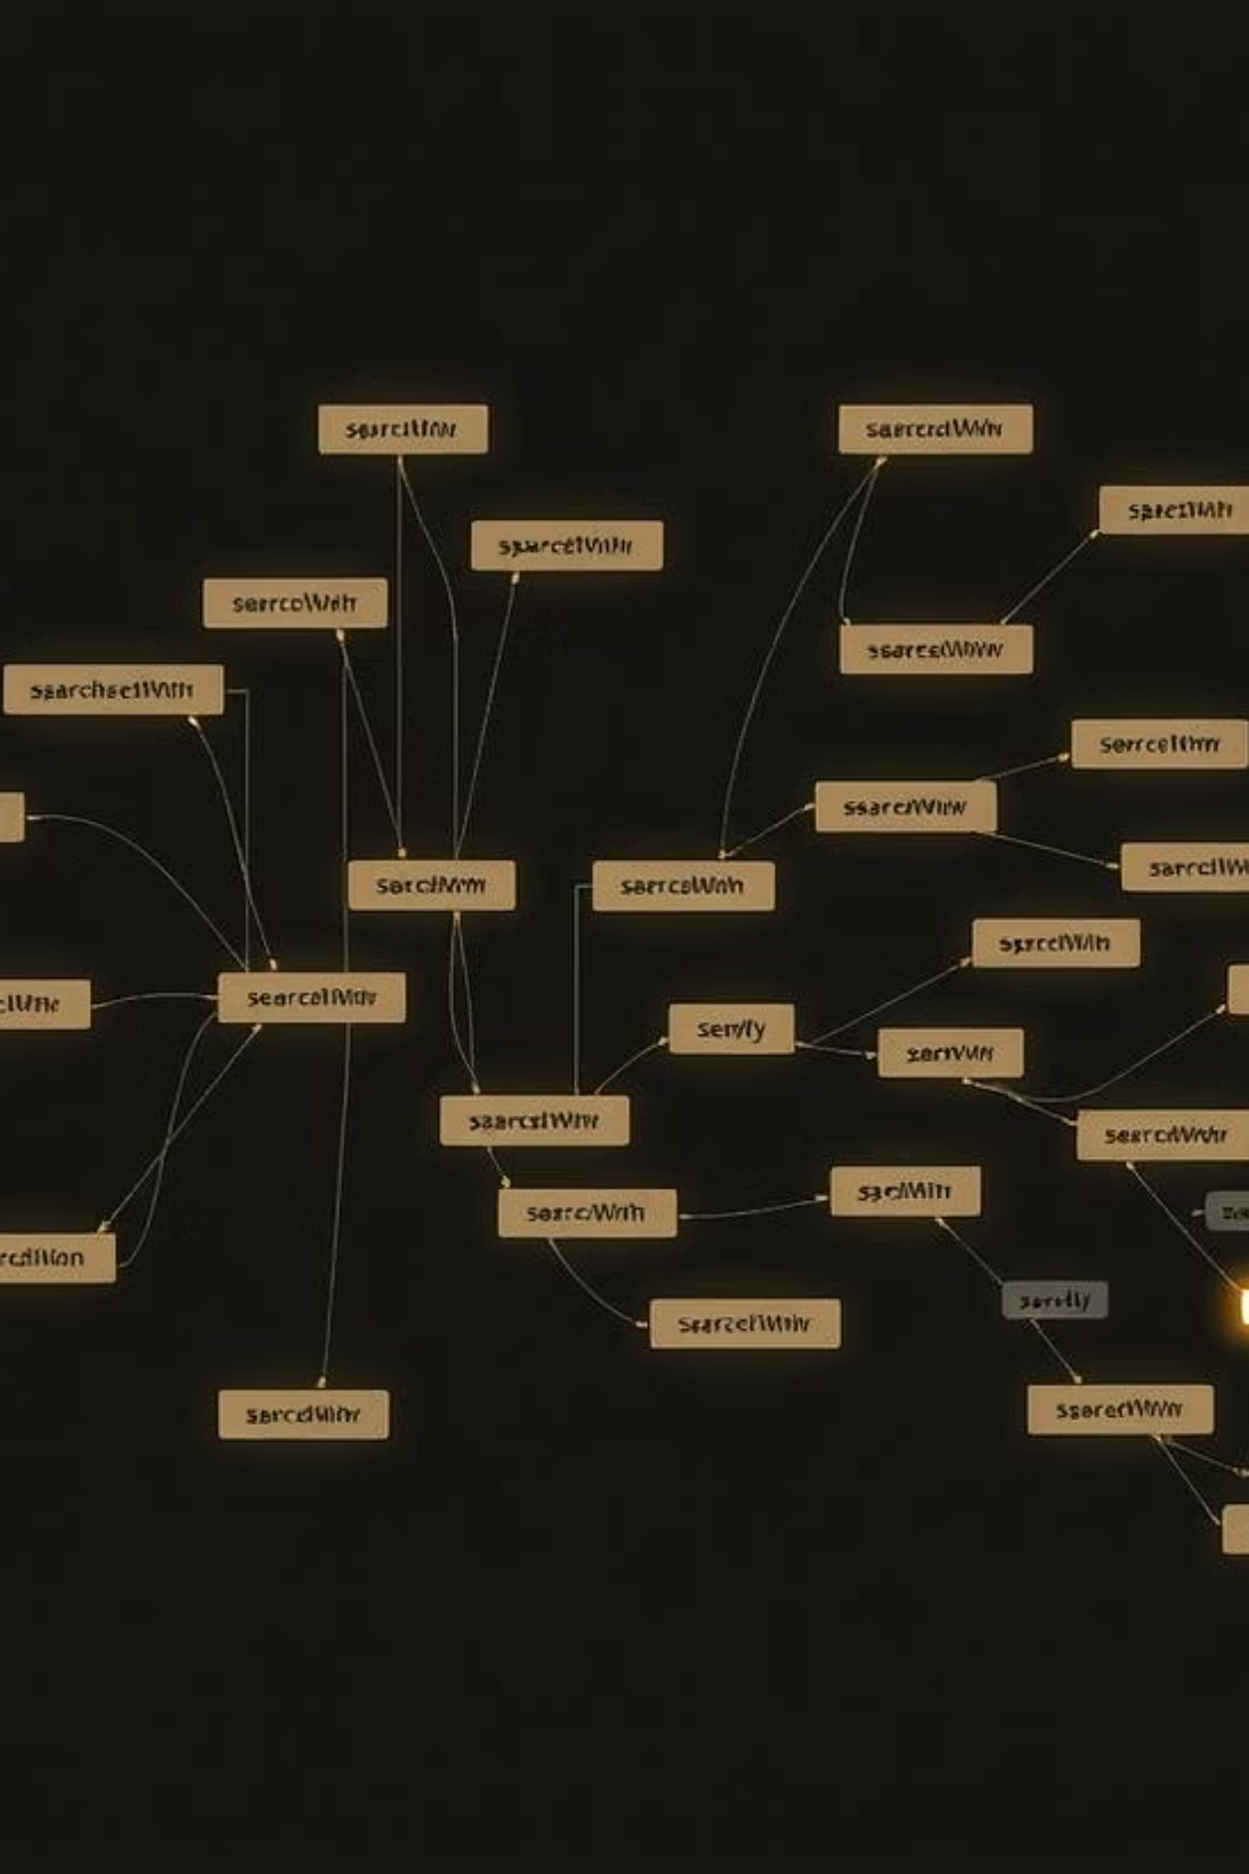
Exploring Search Strategies & Algorithms
Effective search algorithms are crucial for solving problems in AI, enabling agents to navigate complex state spaces.
Uninformed Search
Informed Search
These methods do not use any domain knowledge beyond the problem definition:
These methods use heuristic functions to guide the search, improving efficiency:
Breadth-First Search (BFS)
A* Algorithm
Depth-First Search (DFS)
AO* Algorithm
Iterative Deepening Search (IDS)
Beam Search
Depth-Limited Search (DLS)
Bidirectional Search

Slide 5
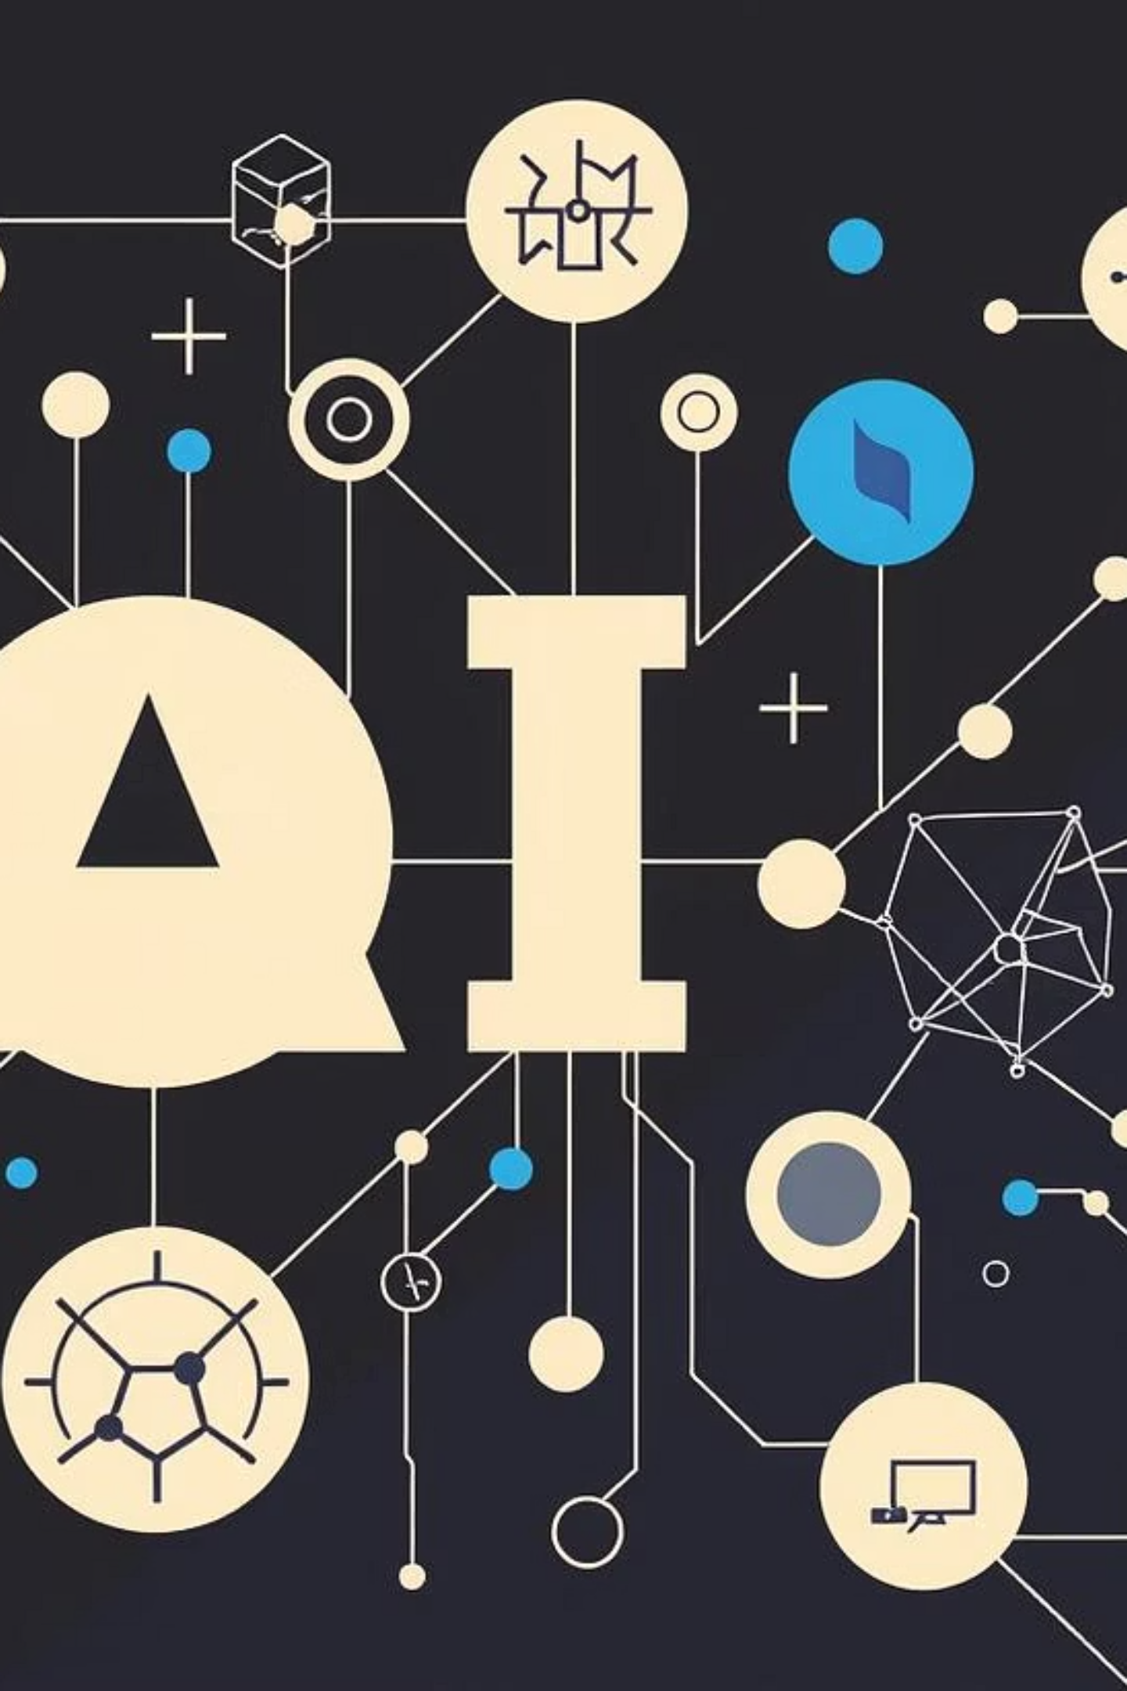




Advanced AI Concepts
Delving deeper into AI, we explore sophisticated techniques for problem-solving and decision-making.
Constraint Satisfaction Problems (CSP)
Solving problems by finding consistent values for variables.
Logical Reasoning
Developing systems that can infer conclusions from premises.
Consistency
Ensuring data and knowledge bases remain coherent and valid.
Probabilistic Inference
Making predictions and decisions under uncertainty.

Slide 6

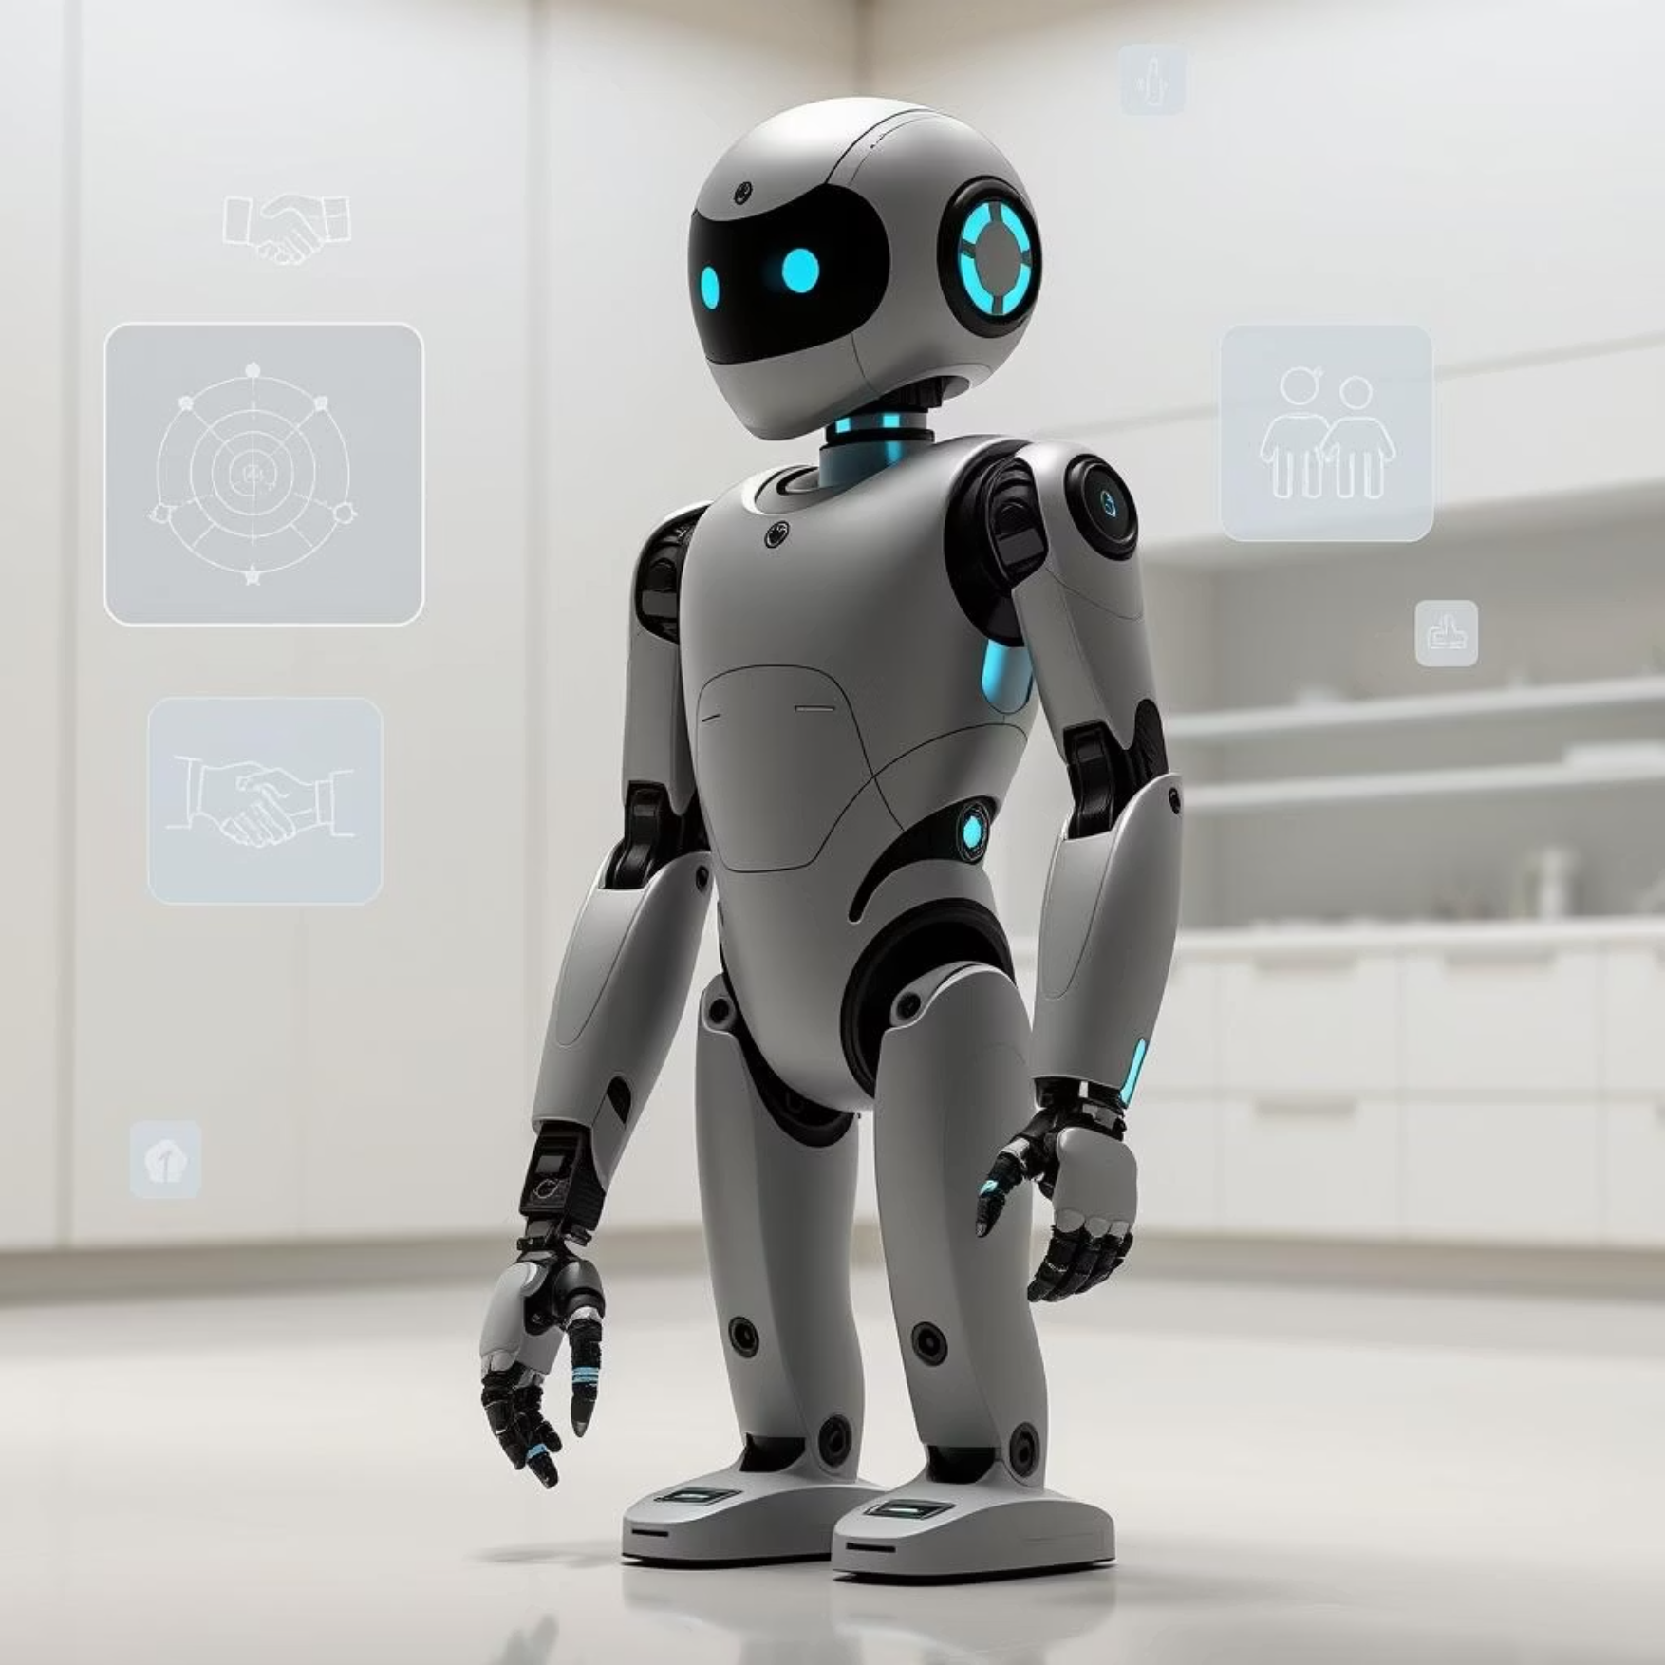
Natural Language Processing & Robotics
Natural Language Processing (NLP)
Robotics
Enabling computers to understand, interpret, and generate human language.
Designing and programming intelligent machines that can interact with the physical world.
Text Processing & Analysis
Sensor & Actuator Integration
Language Understanding & Generation
Motion Planning & Control
Speech Recognition & Synthesis
Human-Robot Interaction

Slide 7
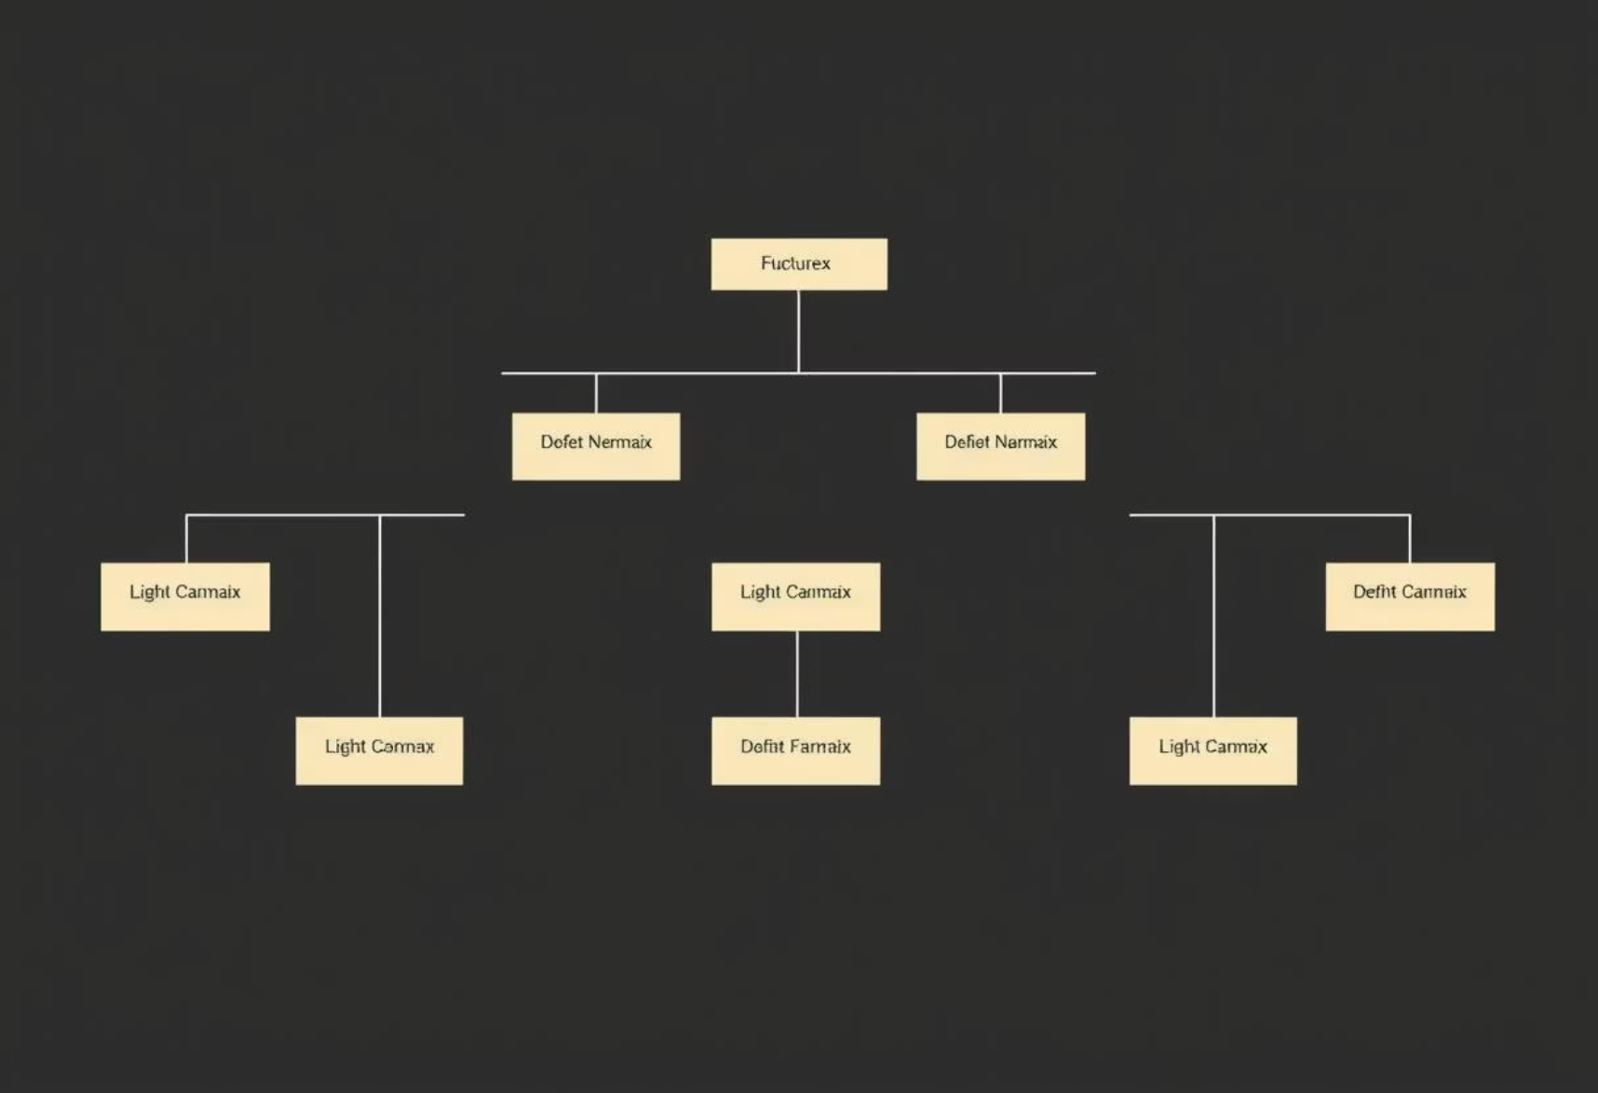


Lab Activities & Algorithm Implementation
Our lab sessions focus on hands-on implementation and performance analysis of core AI algorithms.
Minimax Algorithm
Alpha-Beta Pruning
Implementing game theory for optimal decision-making in adversarial scenarios.
Optimizing minimax search by eliminating unnecessary branches.
We'll also explore code snippets and various performance comparison charts to understand algorithm efficiency.

Slide 8
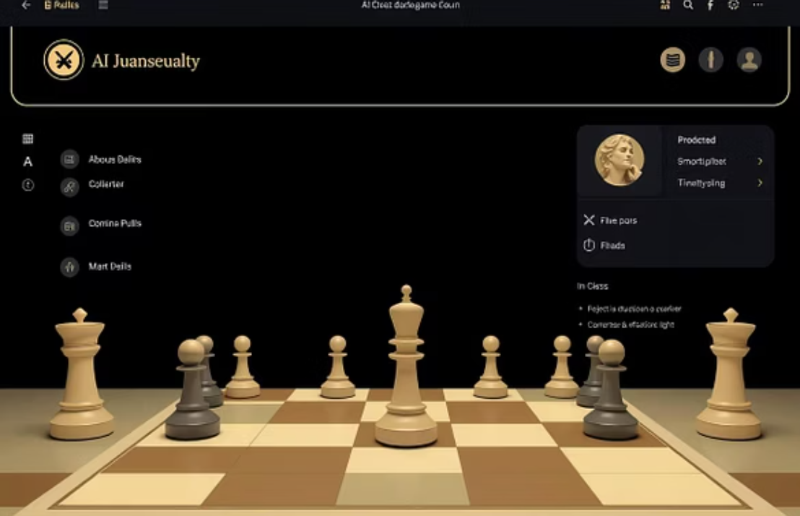
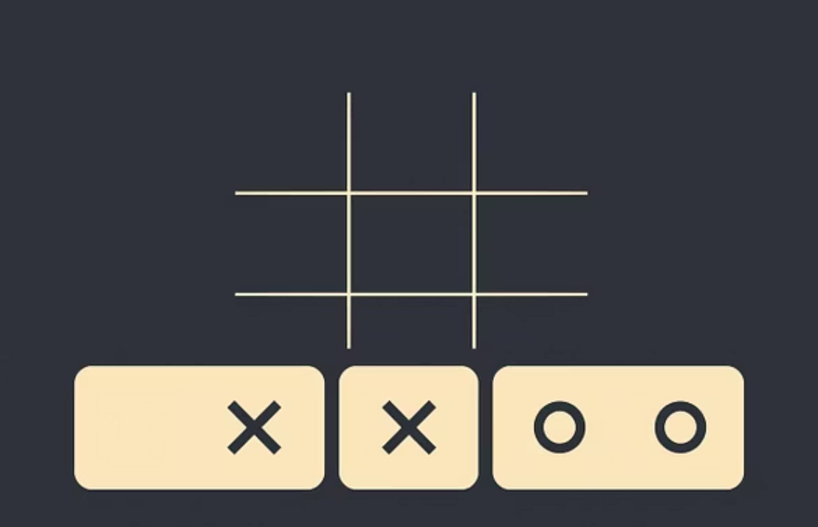
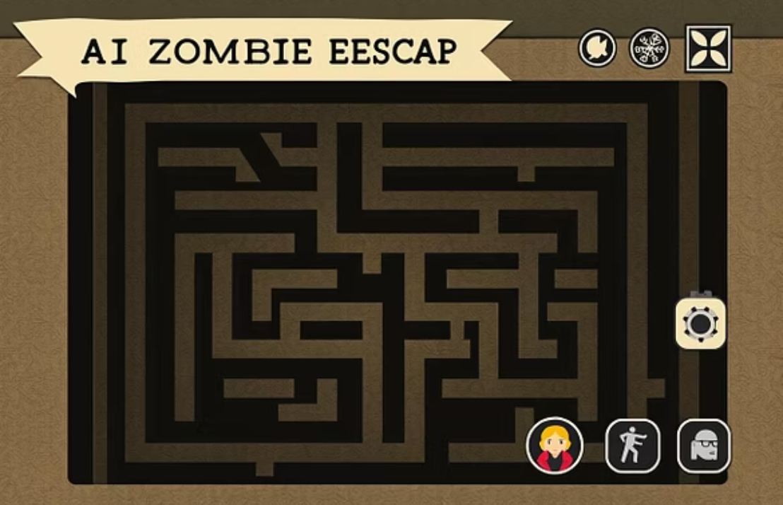
Game Projects Portfolio
Apply learned AI concepts to create engaging game projects.
These projects provide practical experience in implementing AI for strategic gameplay and dynamic environments.

Slide 9
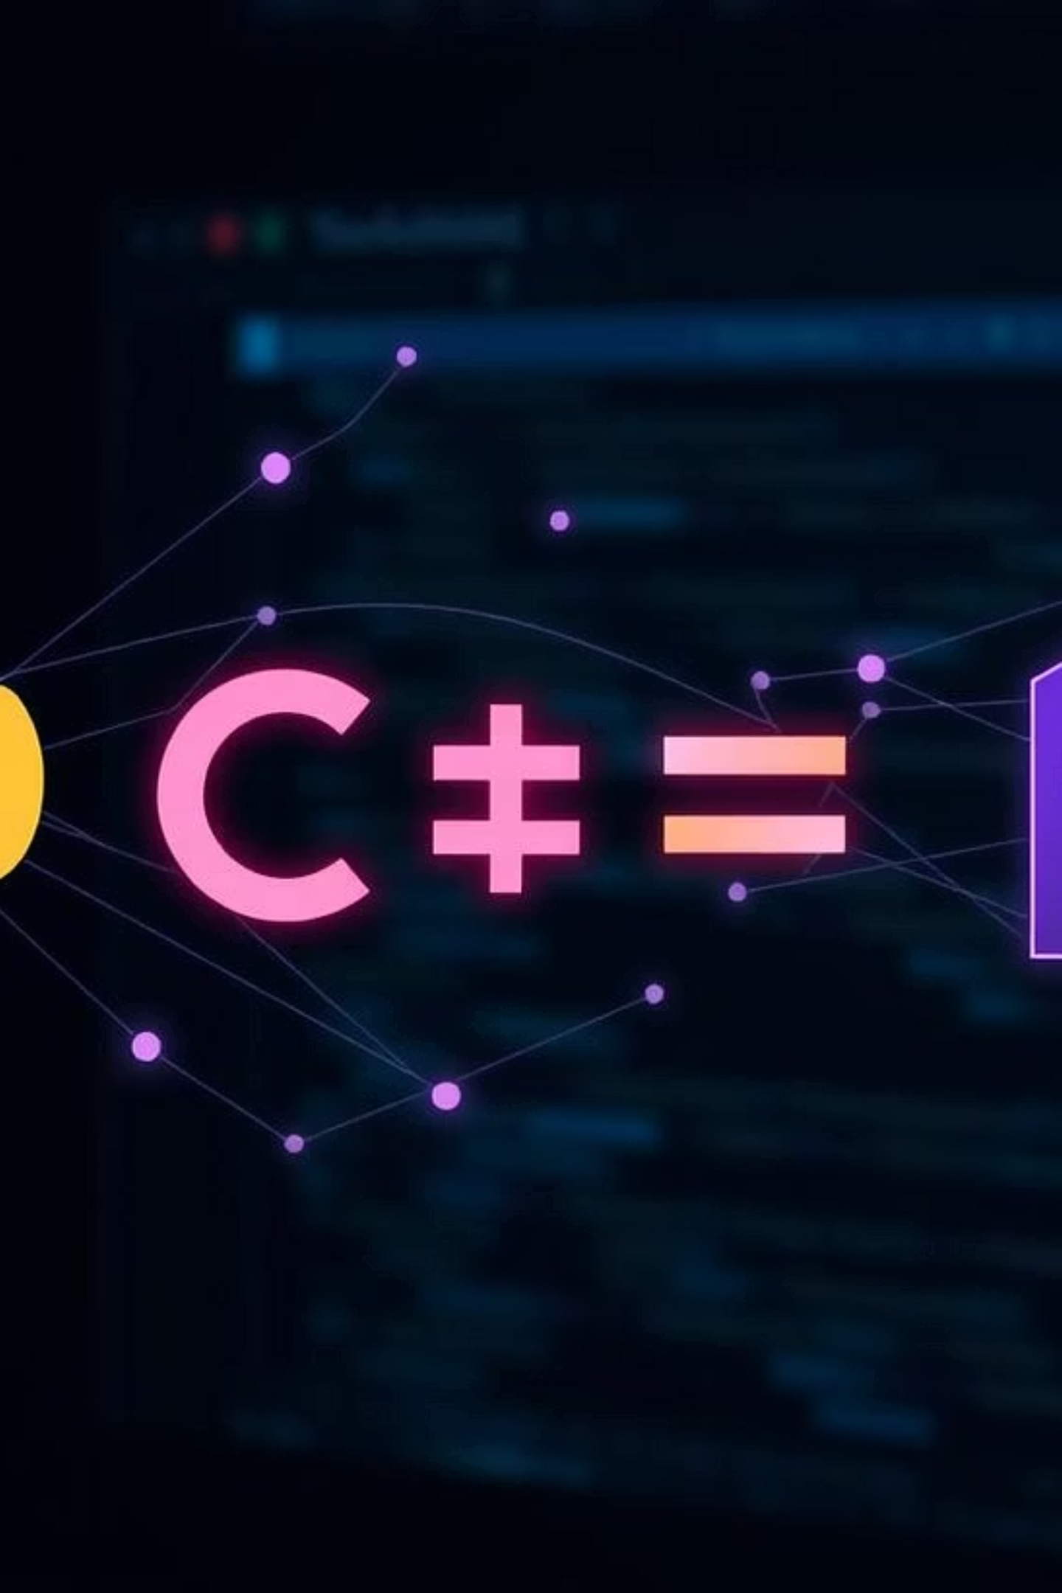



Essential Tools & Technologies
The lab course utilizes industry-standard programming languages and frameworks.
Python
Primary language for AI development.
C++
For performance-critical components.
Pygame
3
Framework for game development.
Tkinter
For building graphical user interfaces.

Slide 10



Learning Outcomes & Conclusion
Key Takeaways
Reflection & Future Steps
Deep theoretical understanding of AI concepts.
Navigating complex AI challenges and celebrating achievements.
Strong practical implementation skills.
Enhanced problem-solving abilities.
Applying learned concepts to real-world scenarios.
Hands-on game development experience.
Opening doors to diverse career paths in AI.
Master AI
Innovate
Succeed

